Slide 1
Stock Portfolio
By Prachi Singh
(Connecture)

Slide 2
Agenda
Introduction
User Stories
Technology Stack
4+1 View
Data Model

Slide 3
Introduction
What is Stock Portfolio Management ?
StockPortfolio is an online stock portfolio analysis system that gives you and your advisors easy access to your most up-to-date performance figures performance review, current stats anytime you need it, from anywhere in the world. We are like web analytics for investing.
With Portfolio Manager you will have a full control over your virtual portfolio. You will be able to track its performance in real time, manage your assets, get full statistics of your portfolio's performance and its technical indicators.

Slide 4
Agenda of Site
What Stock Portfolio Management offers you?
Search for a stock.
See Stock prices of the company.
Add the stock to his portfolio and track it.
User can set alert of a tracked company and if it varies by x% defined by the user, the user will get an alert on email configured.
User can see the graph of the variation of stock price for a year, a day or selected interval of time for a selected stock.

Slide 5
User Stories
Register
Login
Forgot Password
Search by Ticker Symbol
Track Stocks
View Graph
Update Portfolio
Logout

Slide 6
Technology Stack
Framework | Struts2
Web Server | Jetty-6.1
Database | MYSQL -5.5
Building tool | Apache maven-3.0.4
Unit Testing Tool | Junit -4.8.1
Logging Tool | Log4j -1.2.15
ORM –Tool | Hibernate -3.6.0

Slide 7
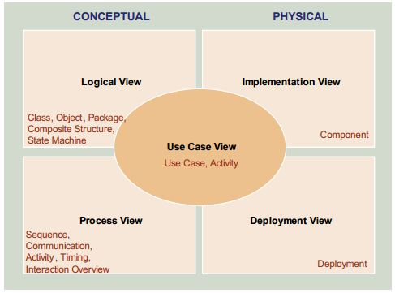
4+1 View

Slide 8
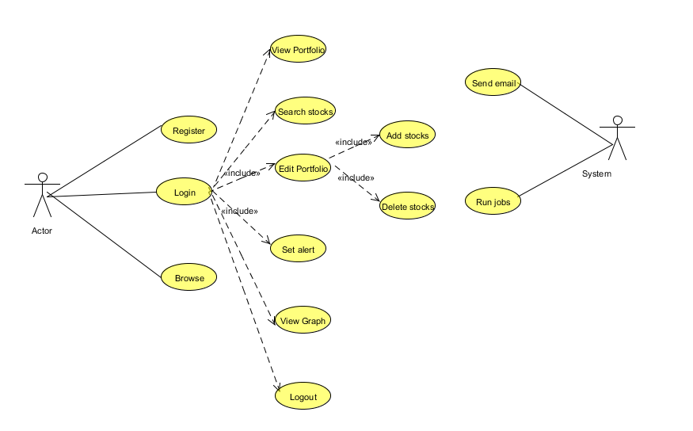
Use Case Diagram

Slide 9
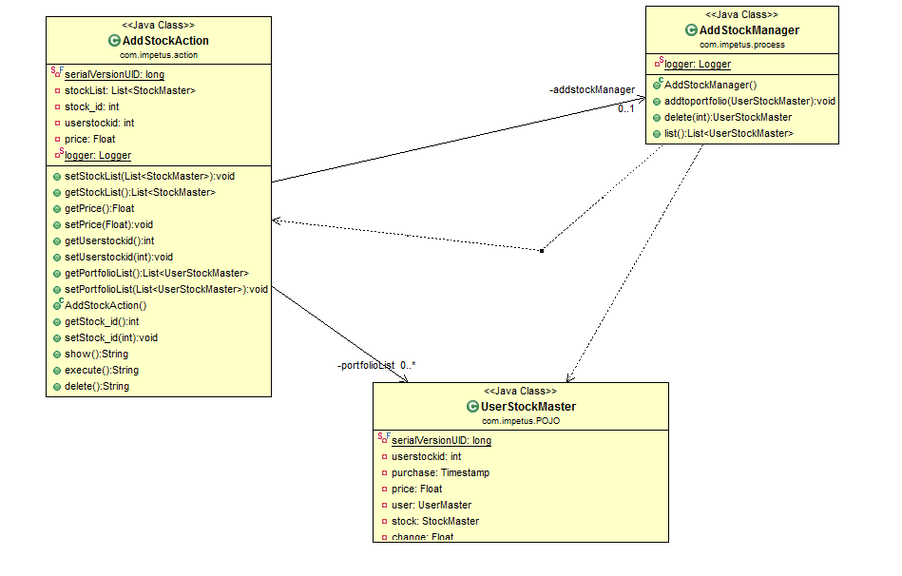
4+1 View: Logical View- Class diagram

Slide 10
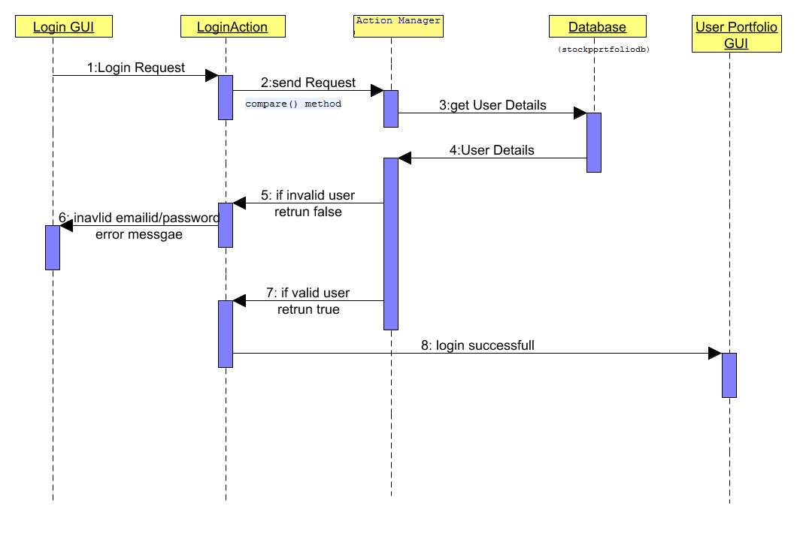
Search Stock Sequence Diagram

Slide 11
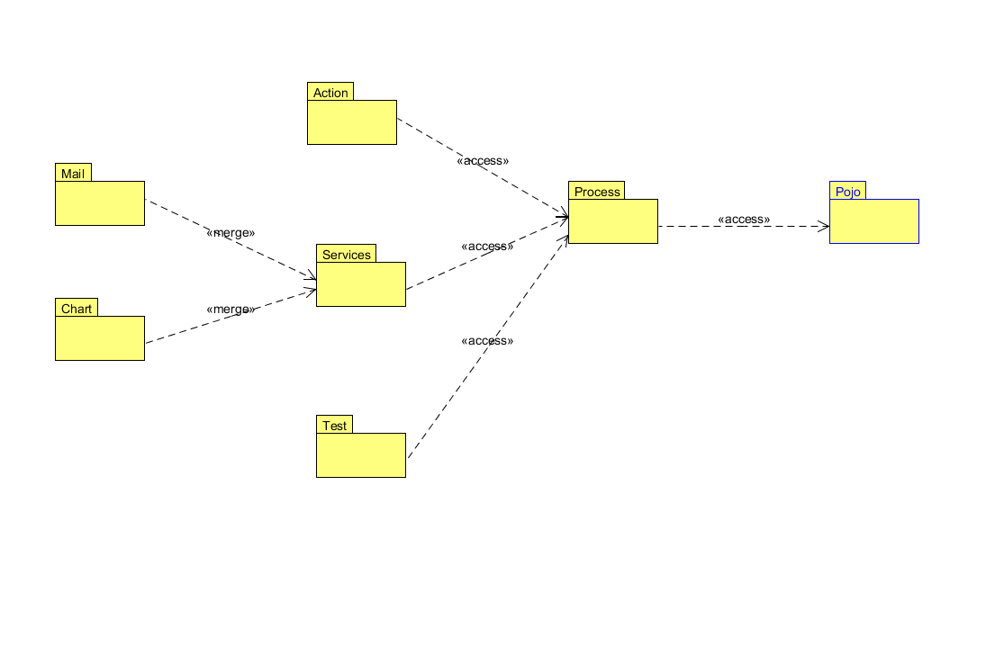
4+1 Views: Development view
Package Diagram

Slide 12
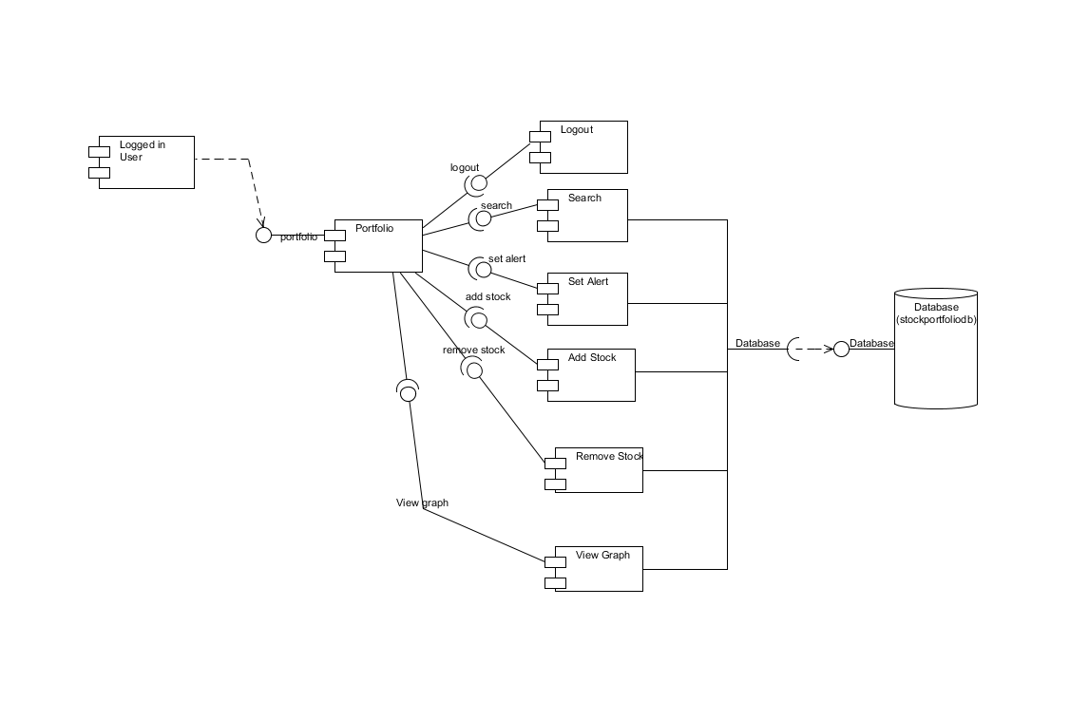
4+1 Views: Development view
Component Diagram

Slide 13
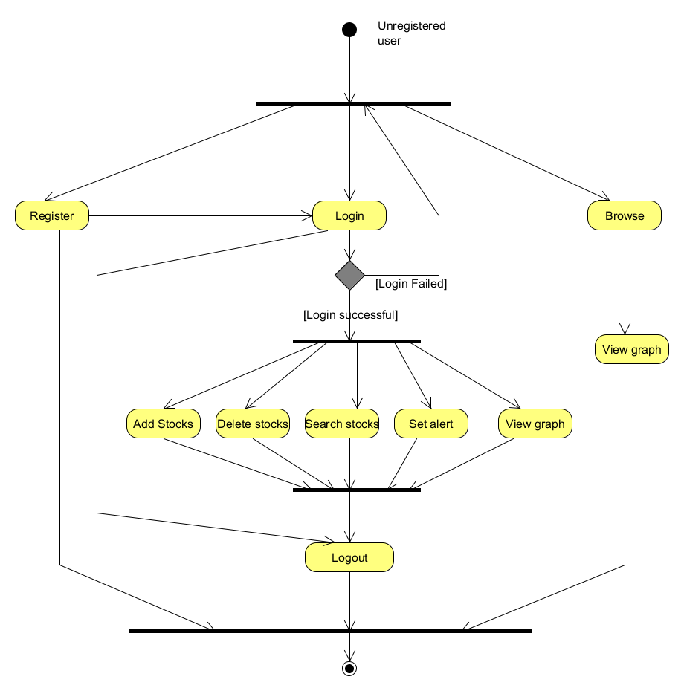
4+1 Views :Process view- Activity diagram
Activity Diagram for User(Login & Search)

Slide 14
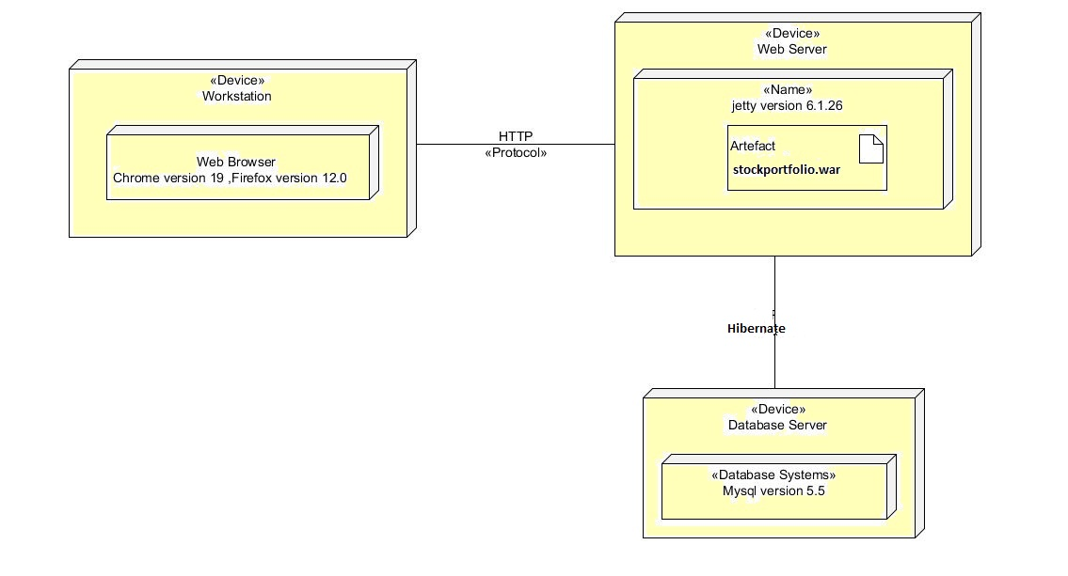
4+1 View: Physical View
Deployment Diagram

Slide 15
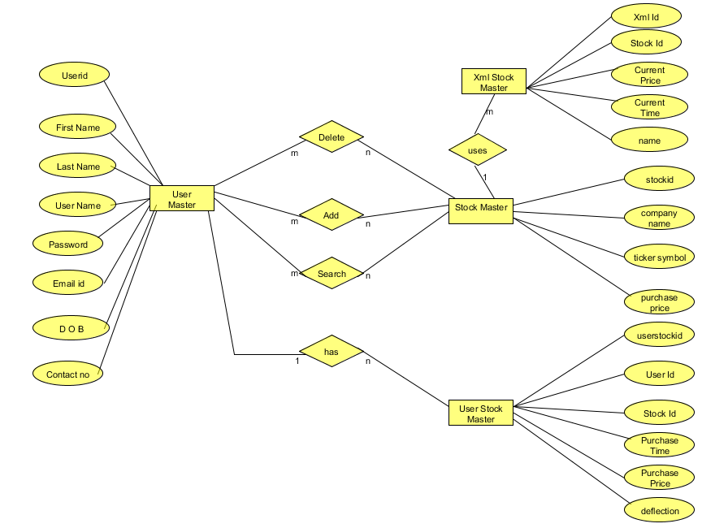
Data Model
ER Diagram
ER Diagram

Slide 16
End
THANK YOU

